Slide 1



UNIT 8;
Time to travel
Eco-friendly travel

Slide 2
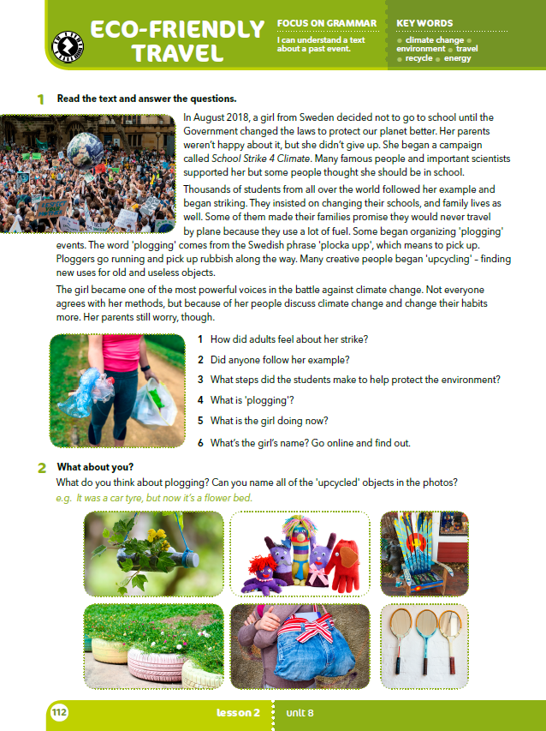
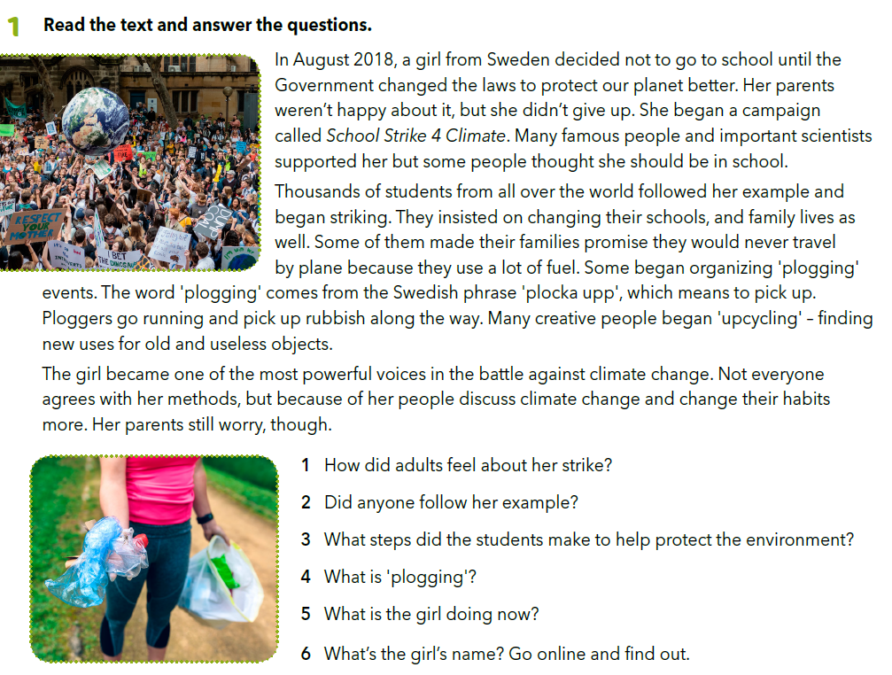
1 Adults weren't happy about it and some people thought she should be in school.
2 Thousands of students from all over the world followed her example.
3 They made their families promise they would never travel by plane, they began organizing 'plogging' events and they began 'upcycling’.
4 'Plogging' comes from the Swedish phrase 'plocka upp', which means to pick up. It means running and picking up rubbish along the way.
5 The girl became one of the most powerful voices in the battle against climate change.
6 The girl's name is Greta Thunberg.
What can you do every day that can harm our environment?
What can you do every day that can help our environment?
Is separating rubbish important? Why?
Why are plastic bags not very popular?
Have you heard about a campaign called School Strike 4 Climate?

Slide 3
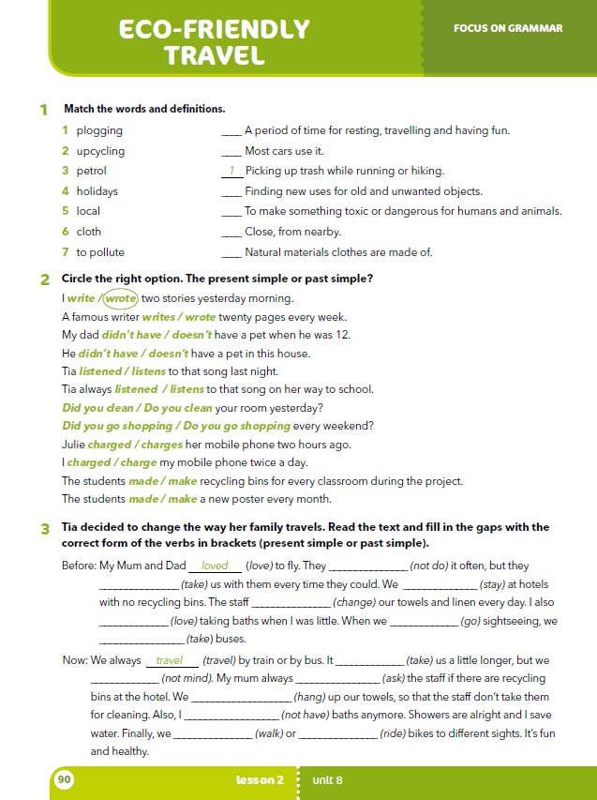
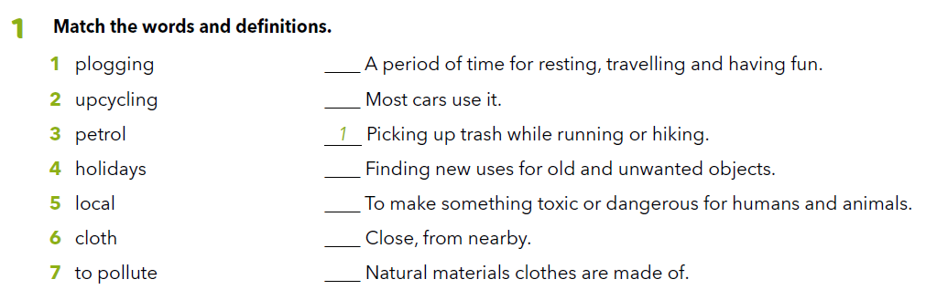
Workbook, p. 90
4
3
2
7
5
6

Slide 4

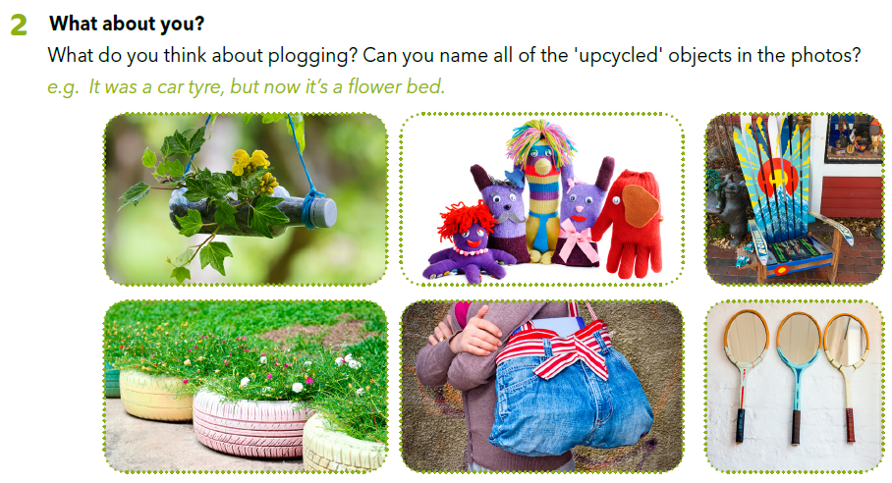

Slide 5
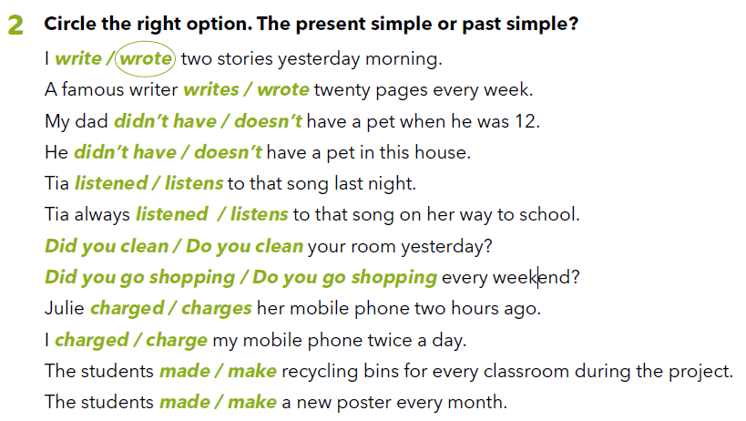

Workbook, p. 90
Present Simple ćeš koristiti u sadašnjosti, a Past Simple u prošlosti!
Present Simple dobivaš tako da glagolu u 3. l. jednine dodaješ nastavak –s/es
Past Simple pravilnih glagola dobivaš nastavkom –d/ed, a nepravilne potražiš u tablici nepravilnih glagola (2. stupac)!

Slide 6
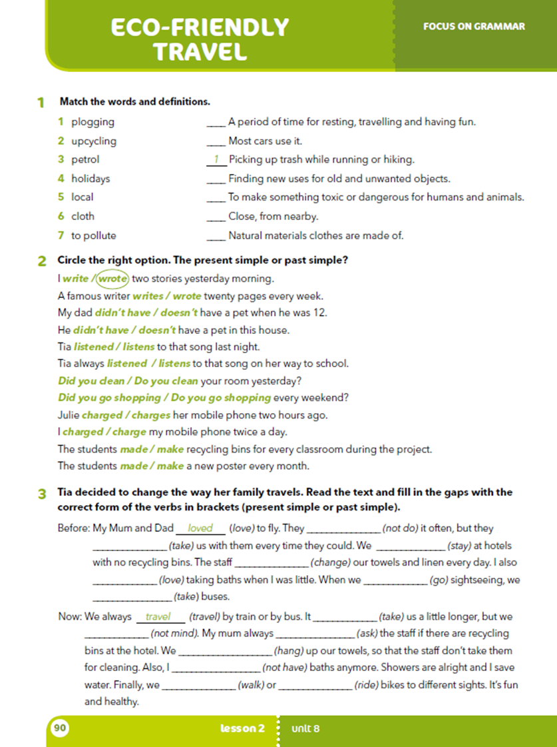
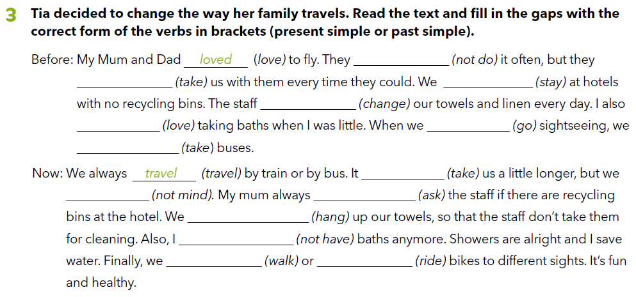
didn’t do
took
stayed
changed
loved
went
took
takes
don’t mind
asks
hang
don’t have
walk
ride

Slide 7
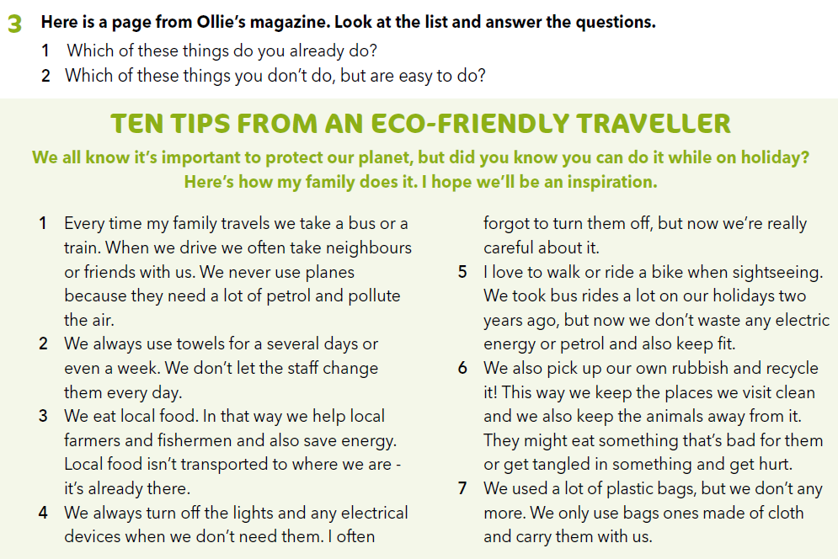

Do you have an idea how to behave eco-friendly when you travel?
How can you save energy on your trip?
How can you save water?
Can you produce less waste than usually?

Slide 8
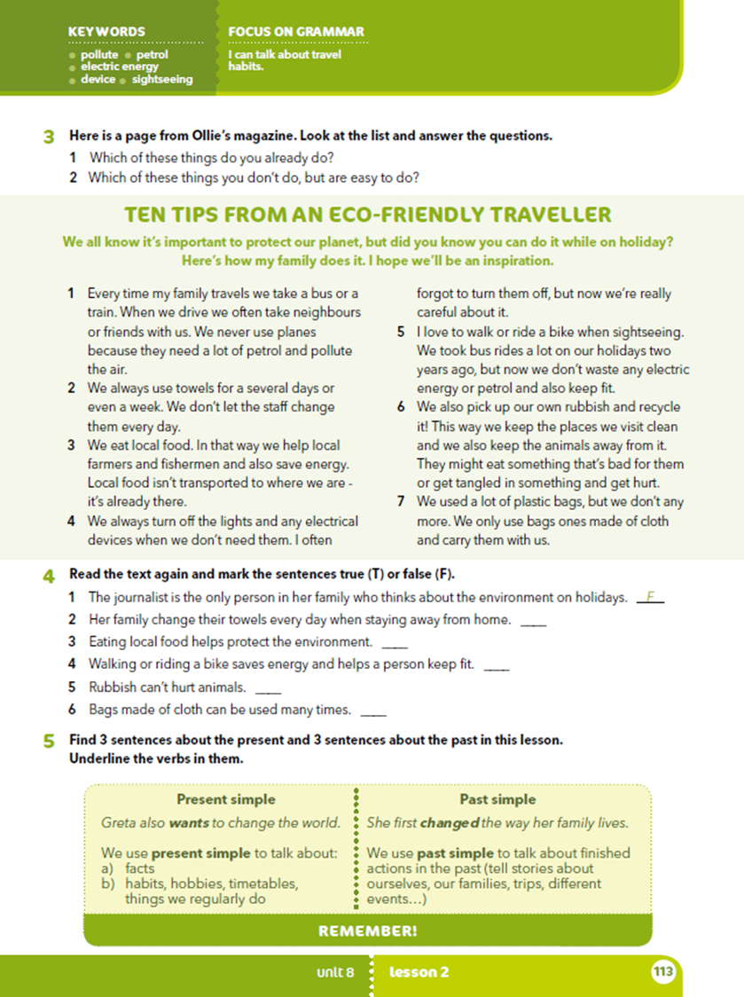
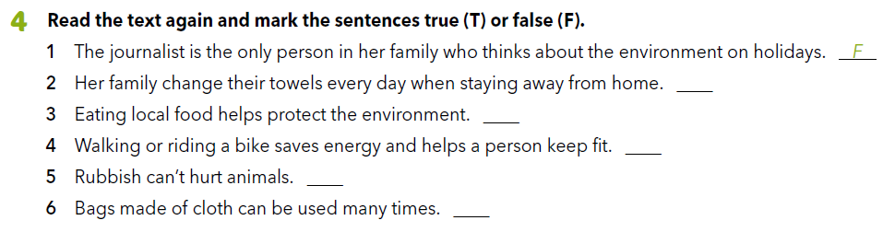
F
T
T
F
T
Let’s practise:
https://learningapps.org/watch?v=phm31ojmt20

Slide 9
Whose family is the text about?
How do they save energy while traveling?
How do they save water?
Why do they eat local food?
What are the benefits of riding a bike instead of taking a bus when sightseeing?
Do they use plastic or recycled bags?
Do you think that world would be a better place if everyone behaved like Ollie’s family?

Slide 10
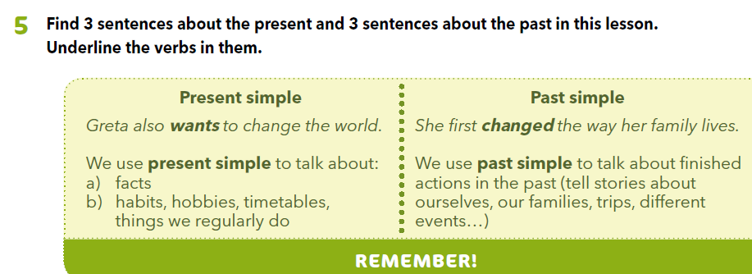
Present Simple ćeš koristiti u sadašnjosti kako bi govorio o činjenicama, navikama, hobijima, rasporedu i stvarima koje redovito radiš, a Past Simple u prošlosti za izricanje završenih radnji!

Slide 11
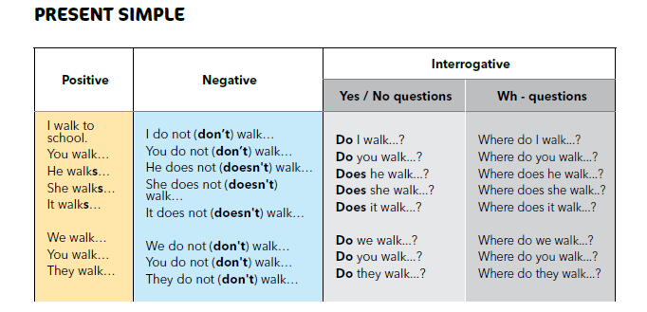

Slide 12
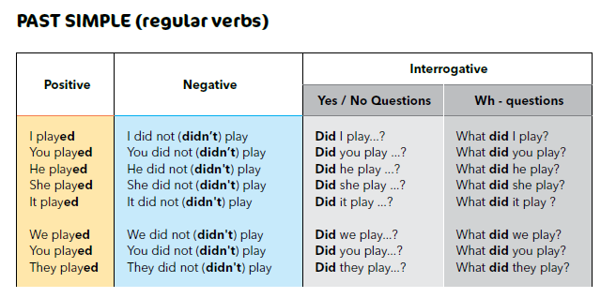

Slide 13

LEARN MORE
https://www.e-sfera.hr/dodatni-digitalni-sadrzaji/18bf7ff0-4762-4e88-b9a0-d5e8cc4d9284/
Travelling to eco-friendly countries
Check your knowledge :
https://www.worldlifeexpectancy.com/world-happiness-map

